Slide 1
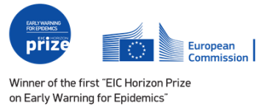
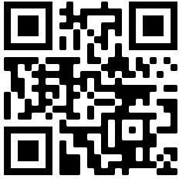


Earth observation-based modelling and forecasting - The EYWA EWS for MBDs
Presenting: Charalampos (Haris) Kontoes
National Observatory of Athens | Institute for Astronomy & Astrophysics, Space Applications and Remote Sensing | BEYOND Center for EO Research and Satellite Remote Sensing
Our vision for #OneEuroGEO
EuroGEO is a pioneering initiative focused on advancing Earth Observation in Europe. With a commitment to sustainability and innovation, EuroGEO plays a key role in coordinating efforts, fostering collaboration, and promoting the use of Earth Observation for the benefit of society and the environment.
Visit the website for more

Slide 2
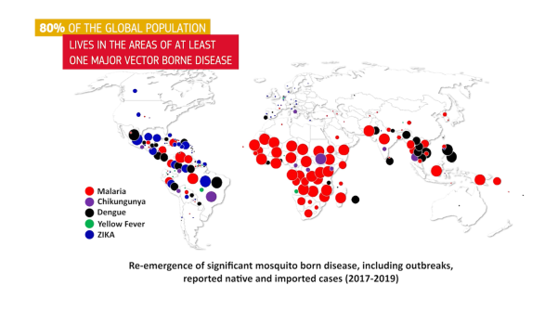

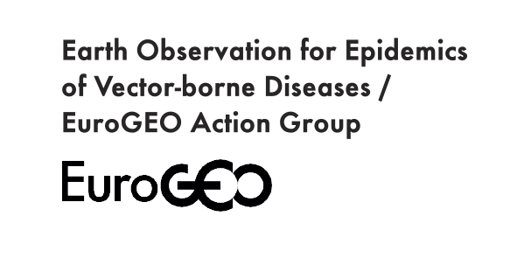
Background and Motivation for EYWA
Accurate and interpretable mosquito and disease prediction maps are essential for mitigating the effect of Mosquito-Borne Diseases.
Vector-Borne Diseases account for 17% of global infectious diseases and cause 700.000 deaths annually
Climate change, unplanned urbanization, and increased mobility are reshaping disease vector distributions.
Amongst vectors, mosquitoes transmit the deadliest diseases → West Nile virus, Malaria, Zika, Dengue, Chikungunya - Malaria, most lethal for kids aged under five in the sub-Saharan regions.

Slide 3

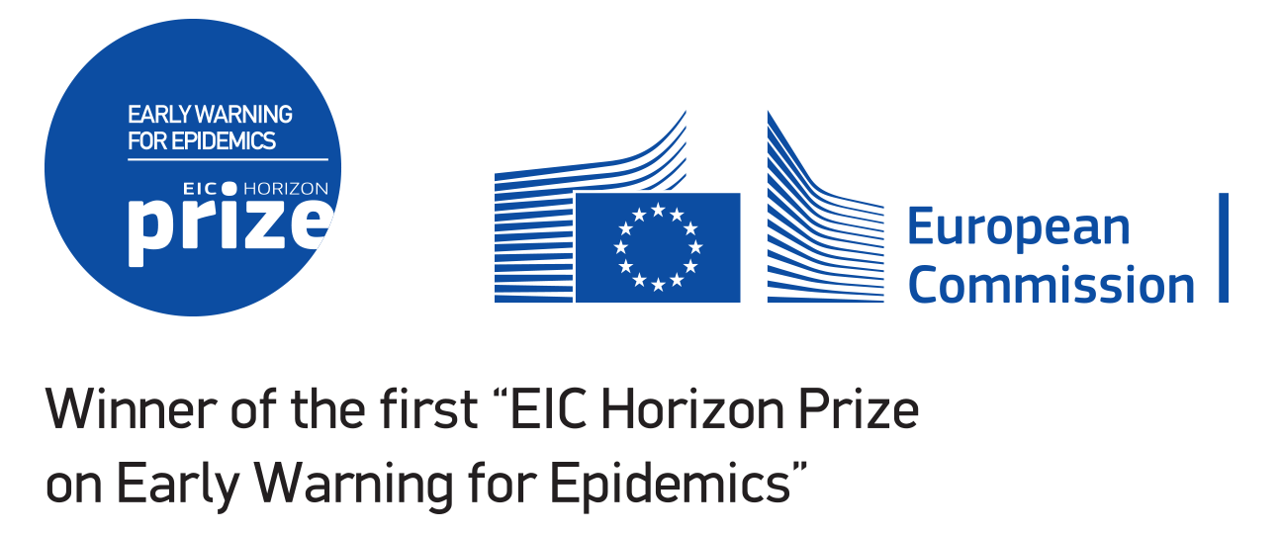
The EYWA journey up to date… in a nutshell
EYWA in discussions to support: Ghana, East Germany, Milan. Also planned cooperation with Pasteur Network to potentially expand to its member countries.
EYWA is operational in Cameroon (Malaria). EYWA is being deployed as an AAS in the DestinE platform
EYWA expanded to include 10 regions in 5 European Countries (France, Germany, Greece, Italy, Serbia)
Research
2020
2022
2024
2021
2023
2025
Two years of thorough research (2018-2020) gave rise to EYWA operations in 5 regions of 2 European Countries (Greece/Italy)
EYWA wins the 1st EIC Horizon Prize on Early Warning for Epidemics &
further expands to support another region in Italy and Cote d’Ivoire in Africa operationally and Thailand in Asia pre-operationally.
EYWA is fostering partnerships with stakeholders from countries in Sub-Saharan Africa, as well as Latin America to expand the system in these affected
regions.
Pre-Operational →
→ Operational Implementation

Slide 4
EYWA in Europe
Greece
1830 cases from 2010 to 2023.
EYWA supports 4 regions with a total of 2500 settlements and 3.8M people.
Entomological risk predictions powered by the BAd (Ecodev) and MAMOTH (BEYOND/NOA) models.
Epidemiological risk predictions powered by the NOA risk model BAr (Ecodev) and MIMESIS (Uni of Patras).
Italy
EYWA supports 2 regions with a total of 757 municipalities and 540K people.
Entomological risk predictions powered by the MAMOTH (BEYOND/NOA) model.
Epidemiological risk predictions powered by the BAr (Ecodev) and MIMESIS (Uni of Patras) models.
France
EYWA supports 3 regions with a total of 9935 municipalities and 12M people.
Entomological risk predictions powered by the MAMOTH (BEYOND/NOA) model.
Epidemiological risk predictions powered by the BAr (Ecodev) and MIMESIS (Uni of Patras) models.
Serbia
EYWA supports Vojvodina regions with a total of 37 municipalities and 1.9M people.
Entomological risk predictions powered by the MAMOTH (BEYOND/NOA) model.
Germany
EYWA supports Baden-Württemberg regions with a total of 47 municipalities and 11.1M people.
Entomological risk predictions powered by the MAMOTH (BEYOND/NOA) model.
Overall 4989 cases and 437 deaths in the past 12 years.
EYWA supports 11 regions in Europe for a total of 10.909 municipalities and more than 34M people living in them.

Slide 5
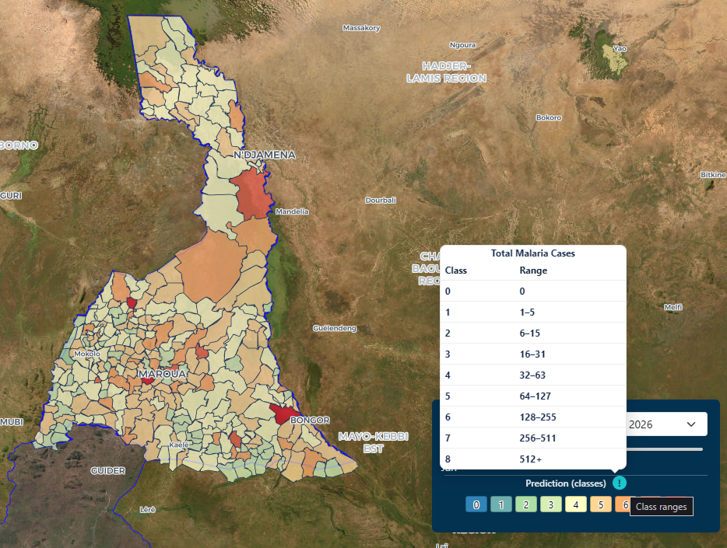
EYWA in the Rest of the World
Ivory Coast
EYWA is operational in Ivory Coast
Malaria in 2022:
28.1M at risk
7.3M suspected cases,
11.000 estimated deaths
1.500 reported deaths
Dengue fever in 2023:
3500 suspected cases,
27 deaths
Thailand
Transferable MAMOTH EYWA model enabled cooperation with Thailand stakeholders
Thailand experienced Chikungunya outbreaks in 2008-2009 (49.069 cases), and 2018-2019 (approximately 15.000 cases
Dengue is hyper-endemic and all 4 serotypes are in active circulation in Thailand.
Latin America
Submission of a plan to implement an EYWA proof of concept to a competition organized by TAKEDA Pharmaceuticals.
500M at risk of Dengue
Cameroon
First Operational Prediction for January of 2026
Malaria in Cameroon from 2015 – 2024 according to our data:
7.5M total confirmed cases
3M Severe Cases
2.5M Hospitalizations
16.890 Reported deaths ~75% (12.000) in Kids Under 5 Years

Slide 6
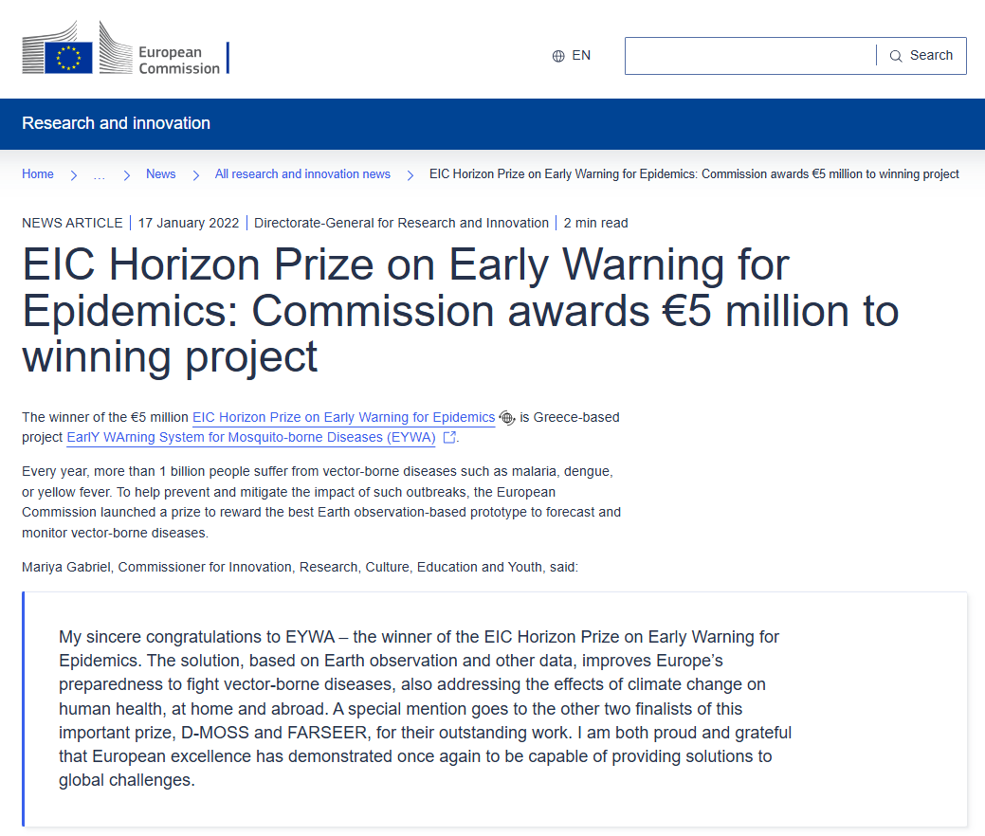
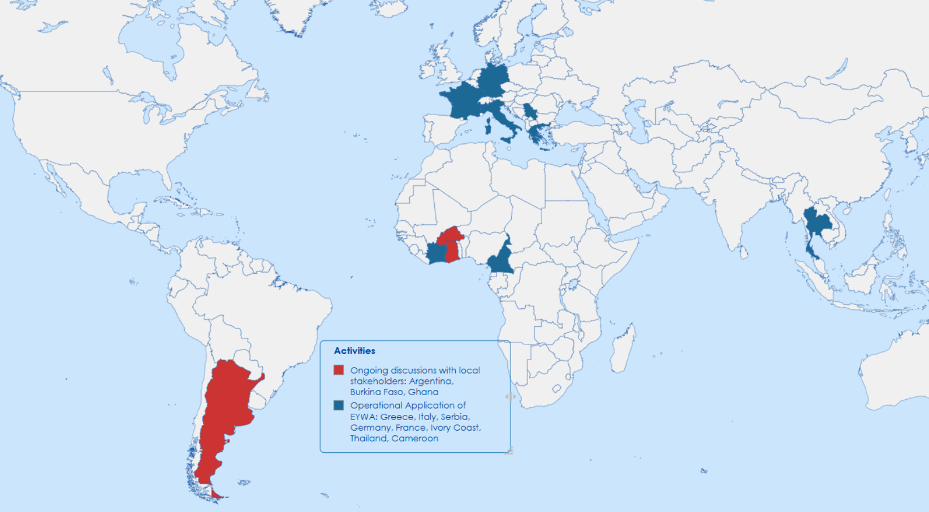
€5 million EIC Horizon Prize on
Early Warning for Epidemics
Notes:
6

Slide 7
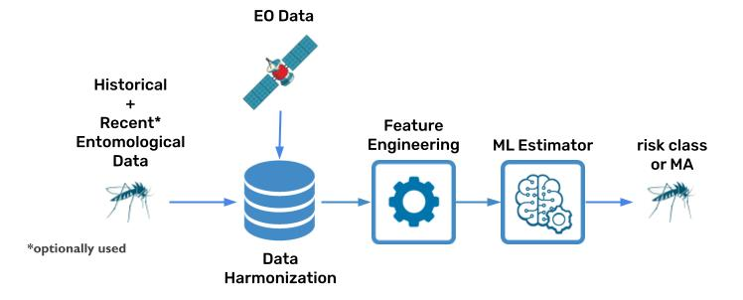
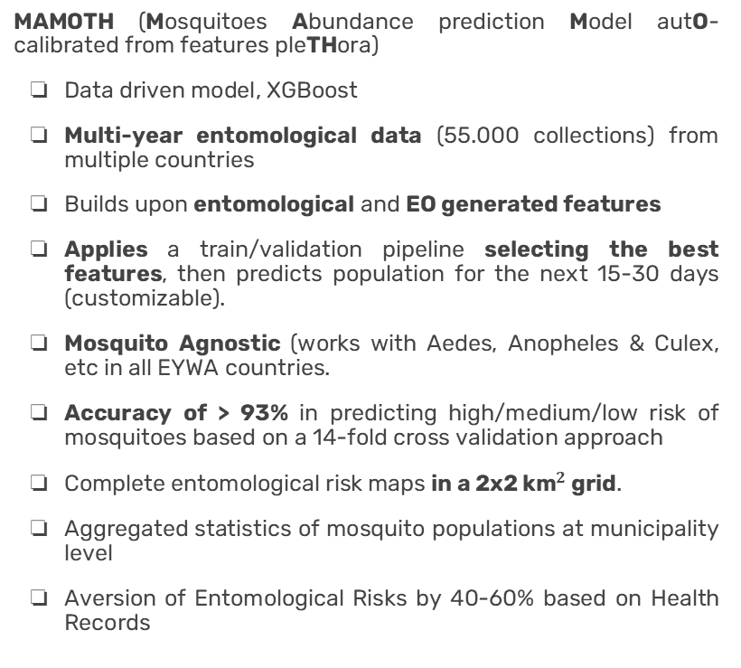
MAMOTH model
Mosquito Abundance
MAMOTH (Mosquitoes Abundance prediction Model autO-calibrated from features pleTHora)
Data driven model, XGBoost
Multi-year entomological data (55.000 collections) from multiple countries
Builds upon entomological and EO generated features
Applies a train/validation pipeline selecting the best features, then predicts population for the next 15-30 days (customizable).
Mosquito Agnostic (works with Aedes, Anopheles & Culex, etc in all EYWA countries.
Accuracy of > 93% in predicting high/medium/low risk of mosquitoes based on a 14-fold cross validation approach
Complete entomological risk maps in a 2x2 ${\text{km}}^{2}$ grid.
Aggregated statistics of mosquito populations at municipality level
Aversion of Entomological Risks by 40-60% based on Health Records
Processing more than 33 TB of Earth Observation data
Environment proxies (Sentinel 2 based NDVI, NDMI, NDWI, NDBI
Meteorological Data (C3S, ERA-5, Seasonal Forecasts): Wind, Land Surface Temperature, Rainfall,, etc
Geomorphological Data CDEM, CLS, CLC and proxies Elevation, Aspect, Slope
Scalable, Transferable, Mosquito agnostic
Notes:
7

Slide 8
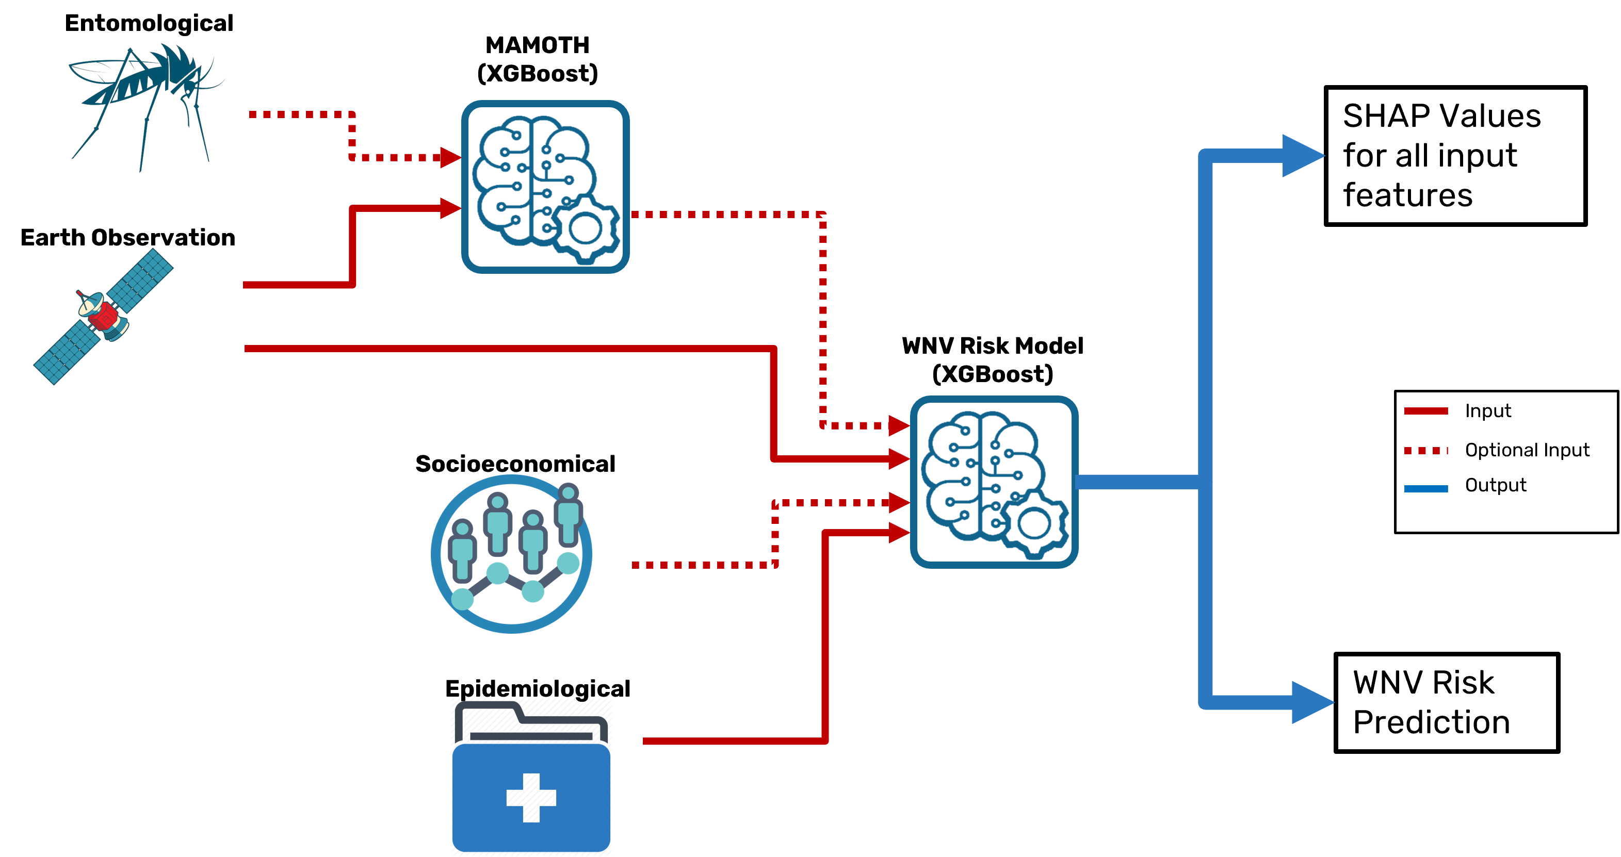
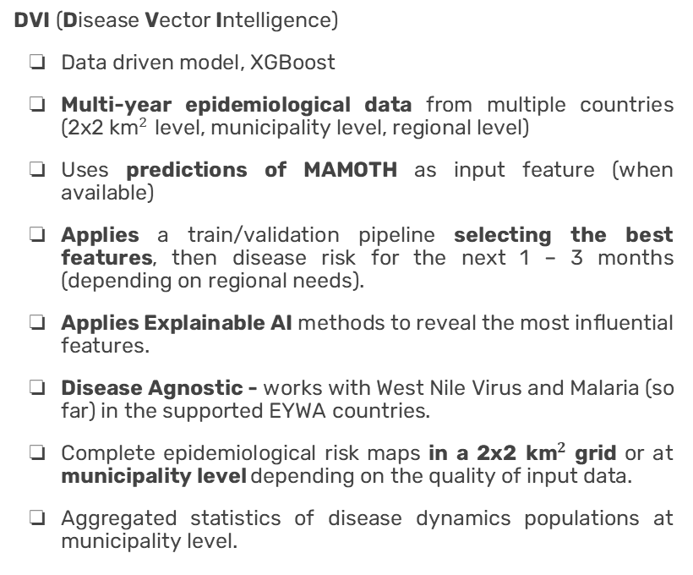
DVI model
MDB Risk
DVI (Disease Vector Intelligence)
Data driven model, XGBoost
Multi-year epidemiological data from multiple countries (2x2 ${\text{km}}^{2}$ level, municipality level, regional level)
Uses predictions of MAMOTH as input feature (when available)
Applies a train/validation pipeline selecting the best features, then disease risk for the next 1 – 3 months (depending on regional needs).
Applies Explainable AI methods to reveal the most influential features.
Disease Agnostic - works with West Nile Virus and Malaria (so far) in the supported EYWA countries.
Complete epidemiological risk maps in a 2x2 ${\text{km}}^{2}$ grid or at municipality level depending on the quality of input data.
Aggregated statistics of disease dynamics populations at municipality level.
Processing more than 33 TB of Earth Observation data
Entomological Data (when available)
Earth Observation Data (Environmental Indices, Temperature, Rainfall, Geomorphological, Land Cover)
Socioeconomical Data (Population, GDP, etc. – when Available)
Scalable, Transferable, Disease agnostic
Notes:
8

Slide 9
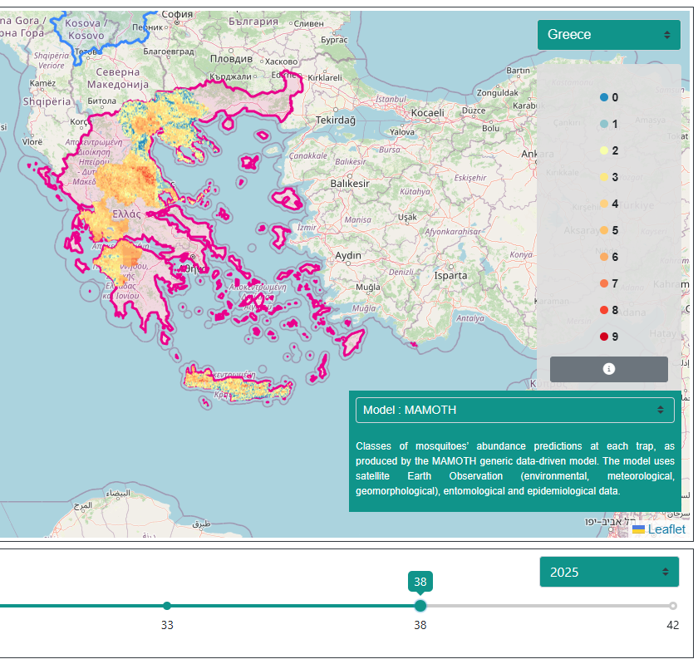
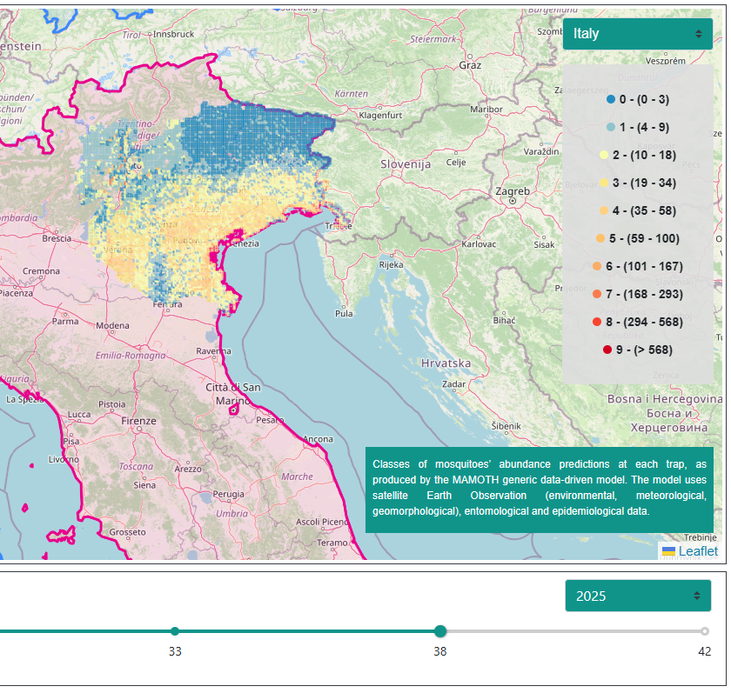
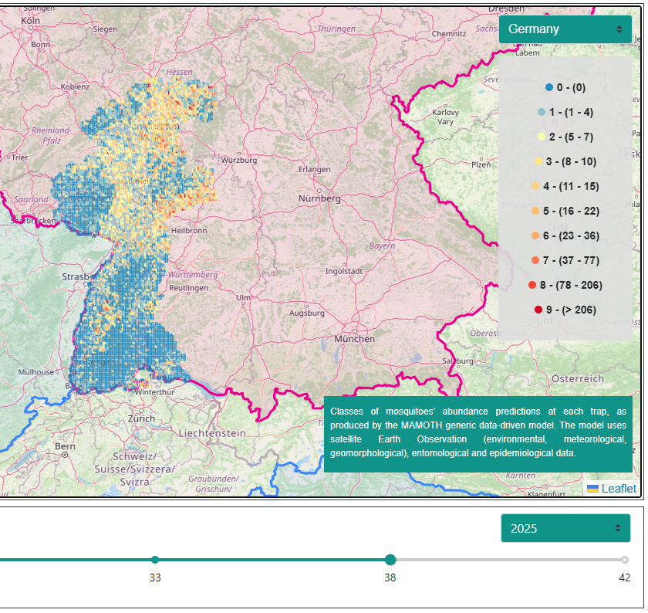
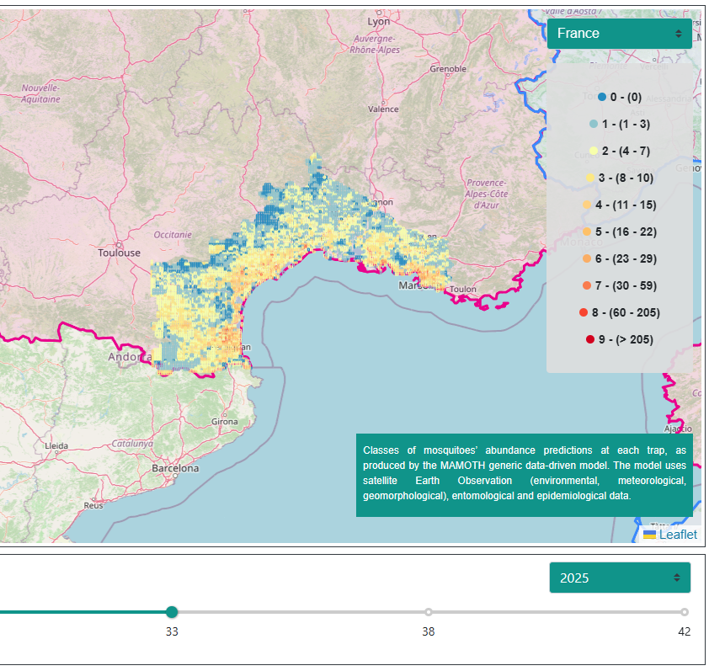
MAMOTH Model – Operational Platform
Greece
Italy
Culex Mosquito Abundance Prediction 2025
Germany
France

Slide 10
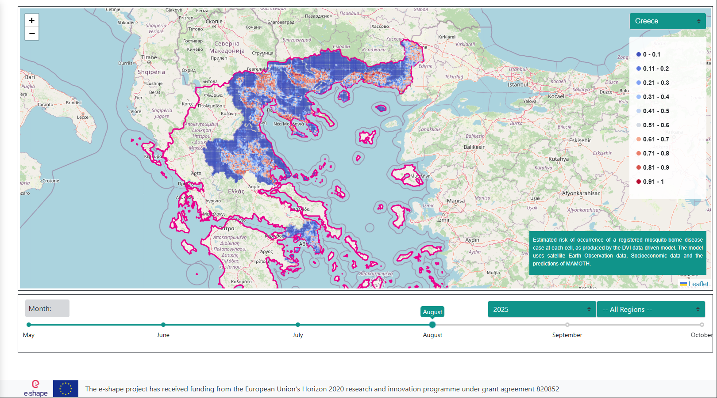
DVI Model in Greece
West Nile virus Risk Prediction 2025

Slide 11
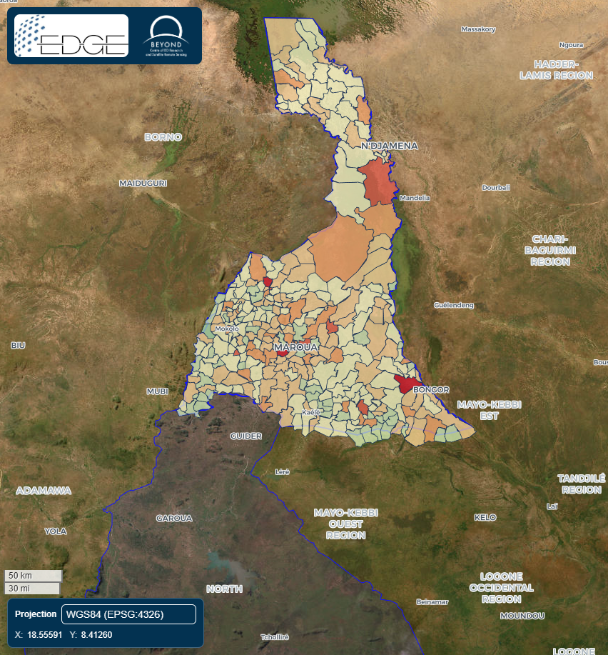
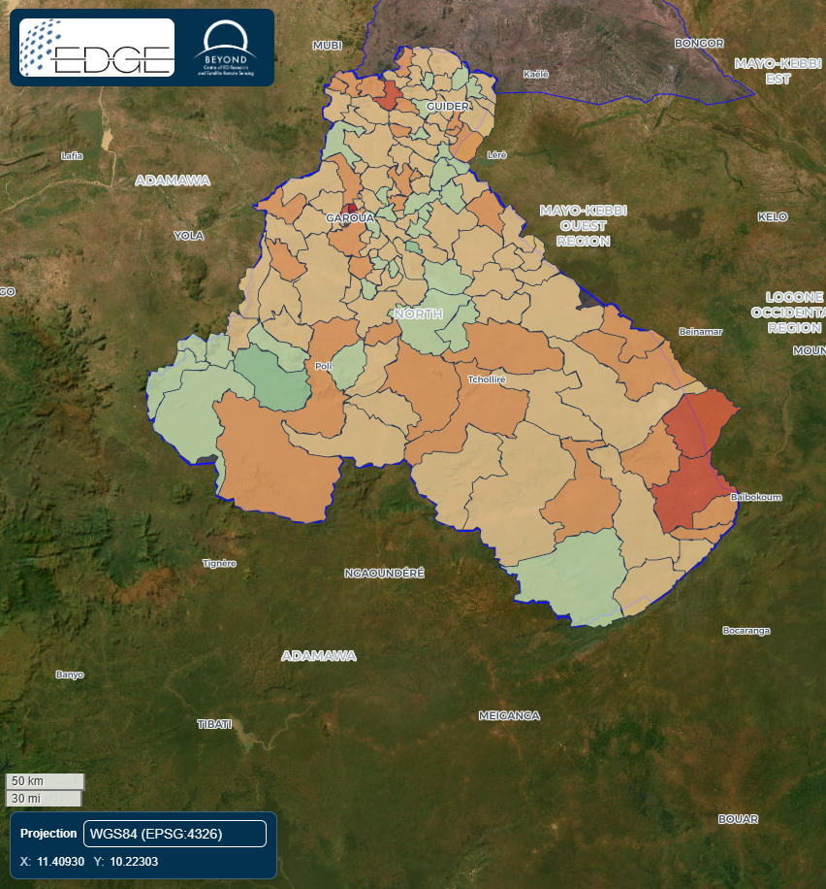
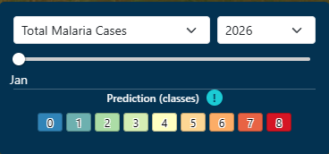
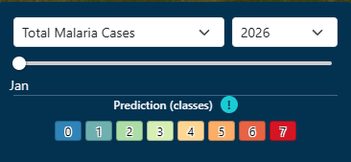
DVI Model in Cameroon
Malaria Risk Prediction 2026!

Slide 12
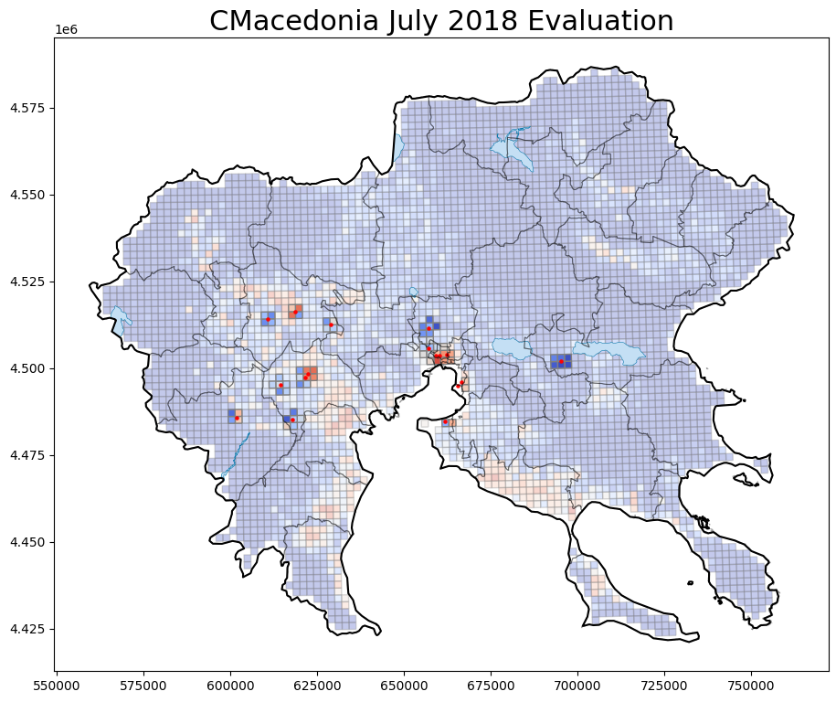
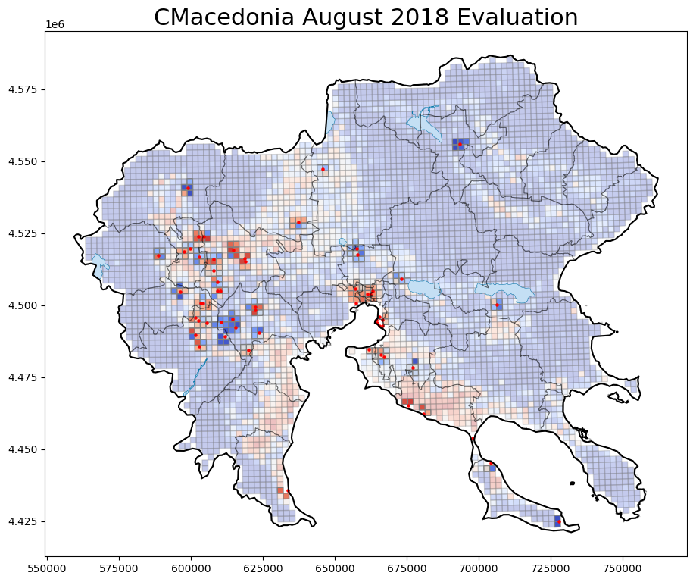
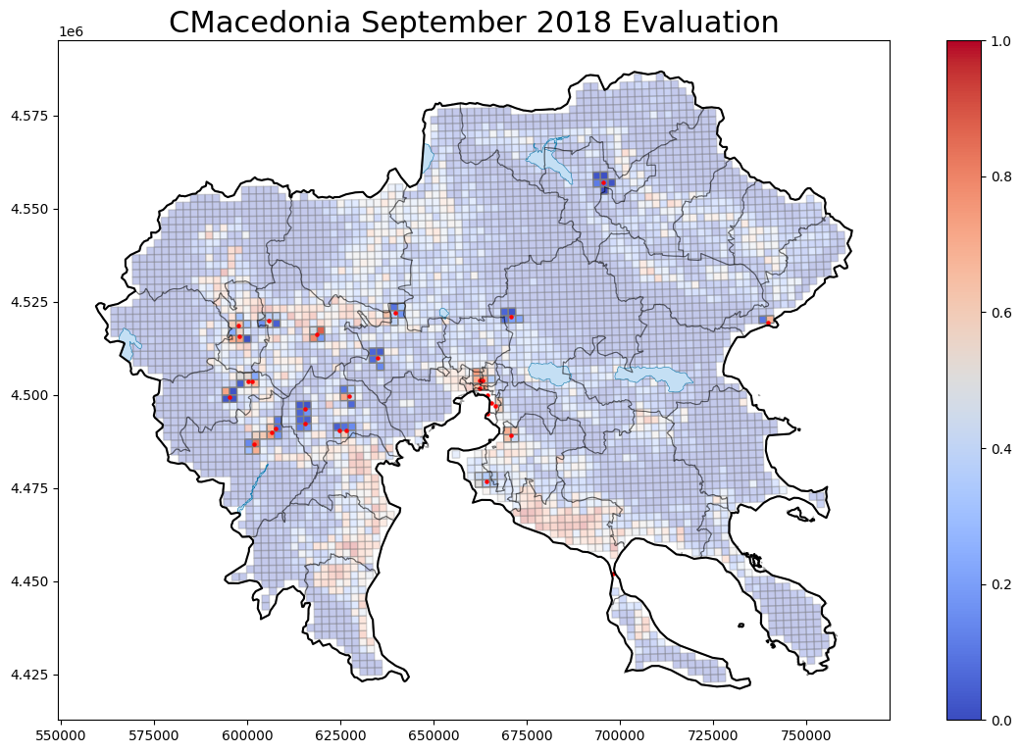
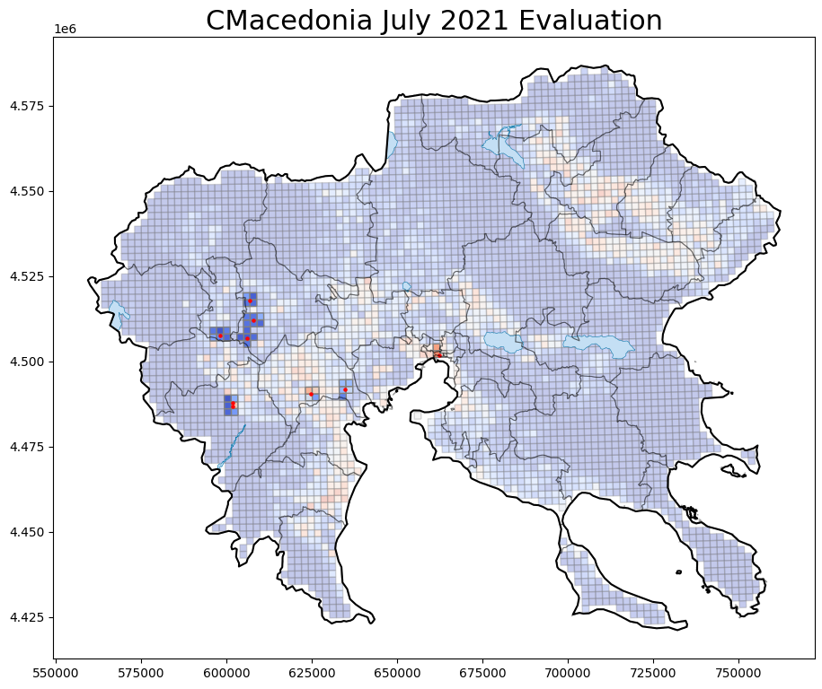
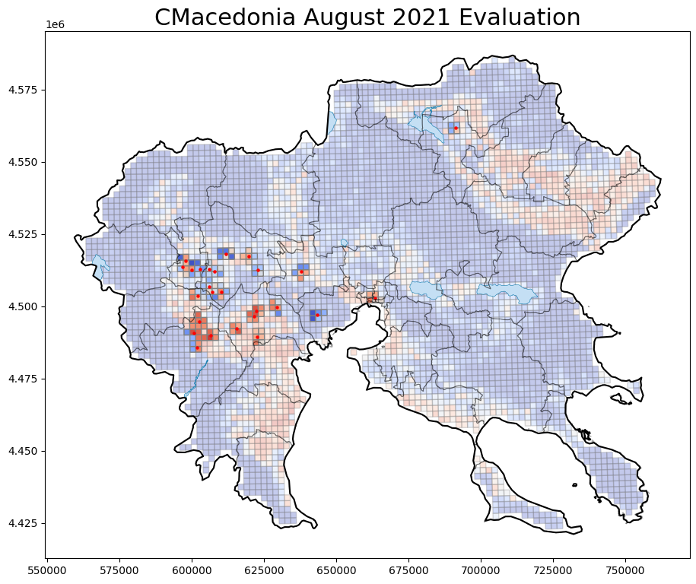
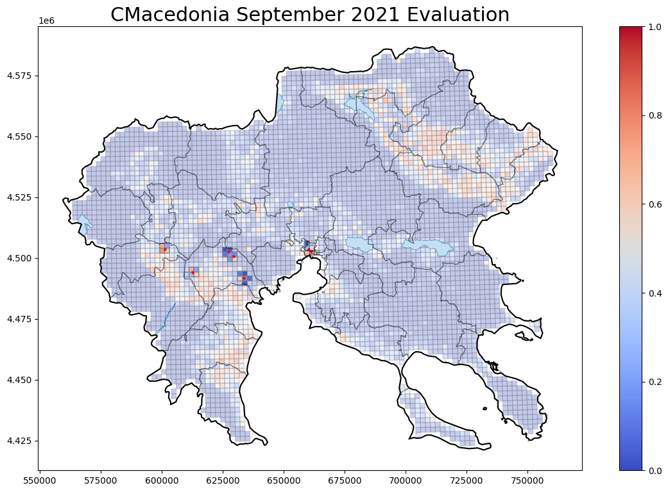
Model Evaluation Greece
% Mean Risk > 0.4
[May - WNV Cases 0] : -
[Jun - WNV Cases 1] : 0.00%
[Jul - WNV Cases: 19] : 58.82%
[Aug - WNV Cases: 62] : 69.49%
[Sep - WNV Cases: 31] : 56.67%
[Oct - WNV Cases: 4] : 25.00%
2018 WNV Cases: 117
2018
% Mean Risk > 0.4
[May - WNV Cases 0] : -
[Jun - WNV Cases 0] : -
[Jul - WNV Cases: 9] : 44.44%
[Aug - WNV Cases: 27] : 76.92%
[Sep - WNV Cases: 7] : 42.86%
[Oct - WNV Cases: 2] : 0.00%
2018 WNV Cases: 45
2021

Slide 13
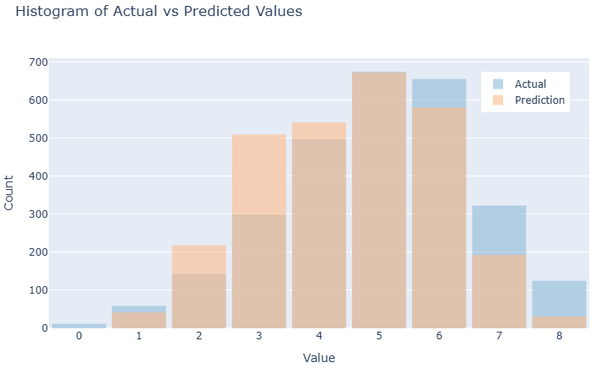
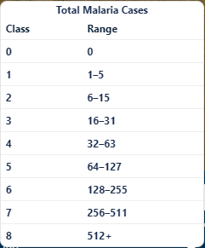
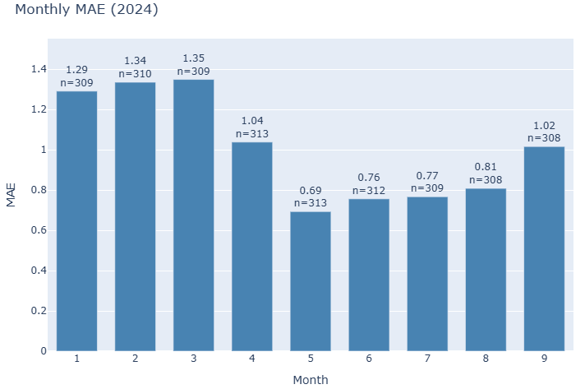
Model Evaluation Cameroon 2024
MAE 2024: 1.0057
Error <= 1 class: 75.92 % min prediction: 1 max prediction: 8

Slide 14
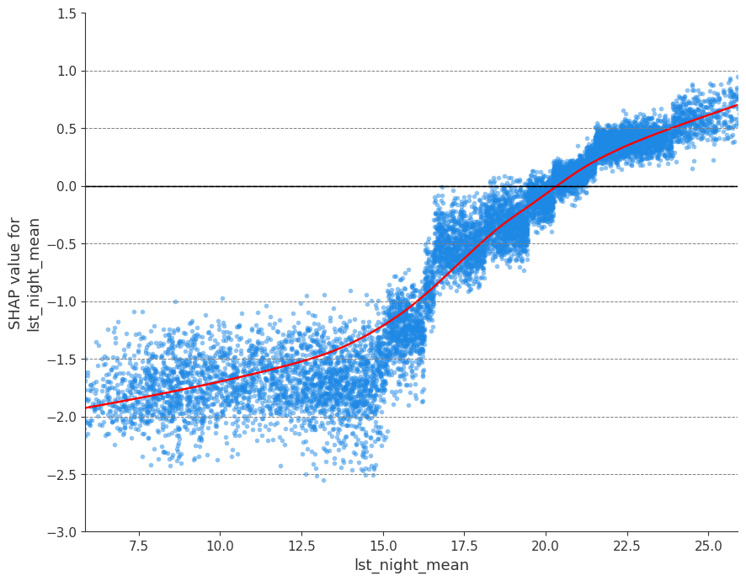
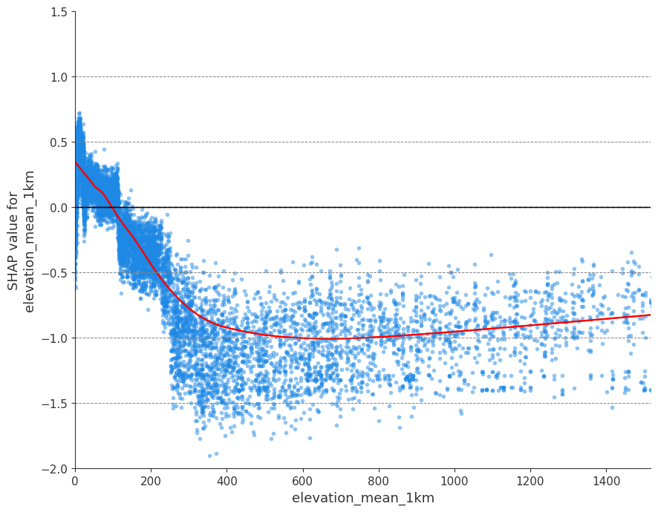
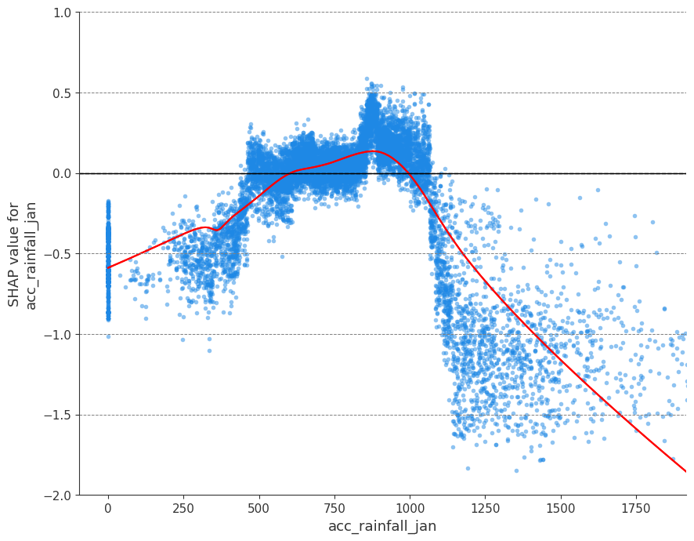
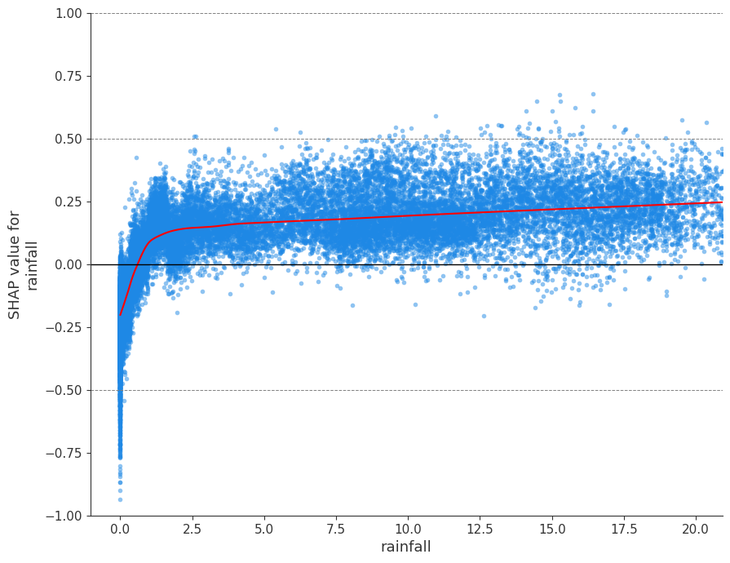
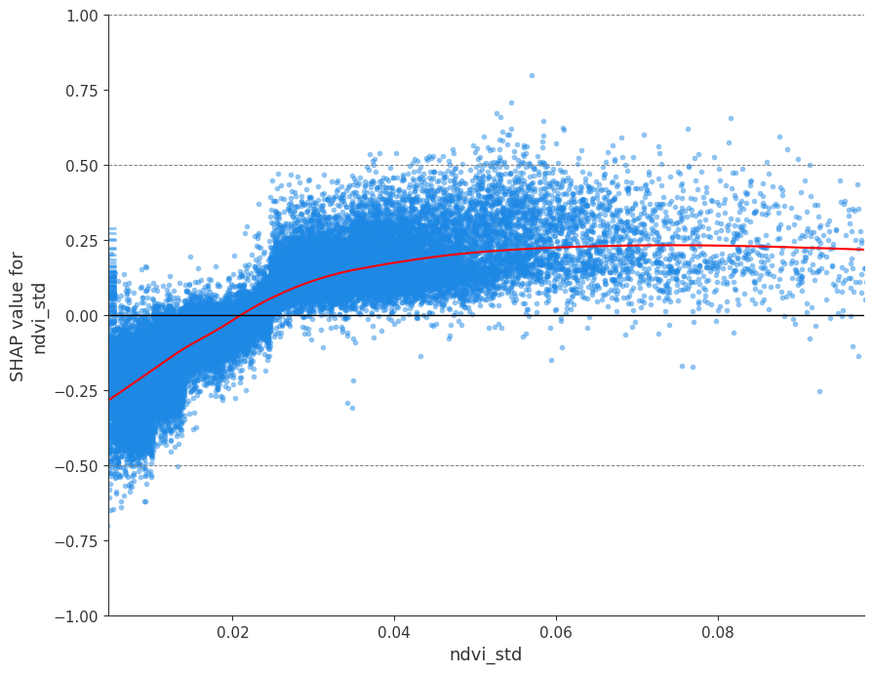
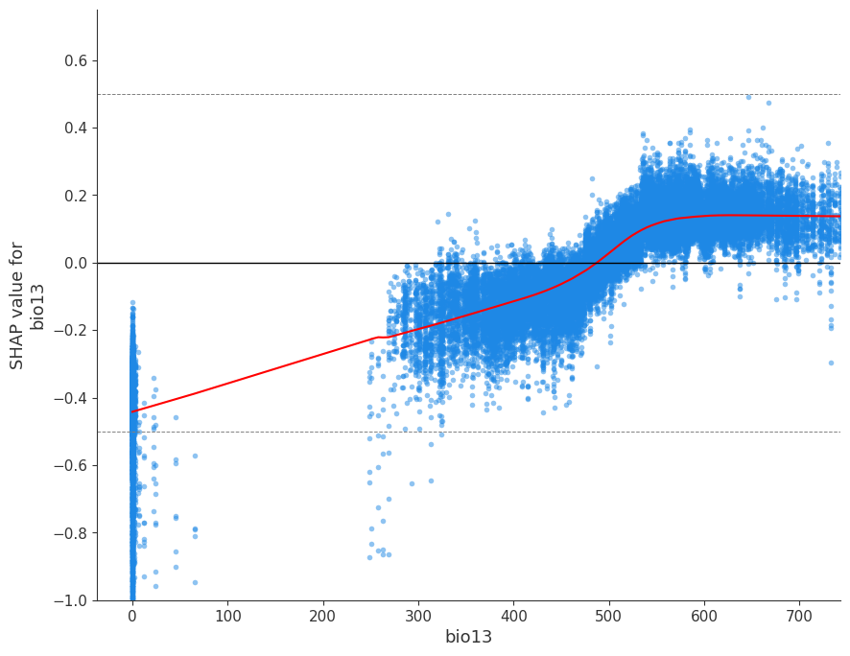
DVI Model Explainability
Nightly Temperature
Mean Elevation
Acc Rainfall from January
Greece
Rainfall of Previous Month
NDVI
Precipitation of Wettest Month
Cameroon

Slide 15
EYWA as an AAS in DestinE platform
EYWA continues to be operational
CONOPS - Early Warning System for Mosquito Borne Diseases Advanced Application: In development
CONOPS will be the continuation of EYWA and will predict mosquito populations and the associated risk of mosquito-borne diseases.

Slide 16
Conclusion and Impact
High-resolution, interpretable EWS
Combines Earth Observation, with entomological and epidemiological data
SHAP enables trust and actionable insights for public health
Scalable to address various mosquito-borne diseases and geographies

Slide 17
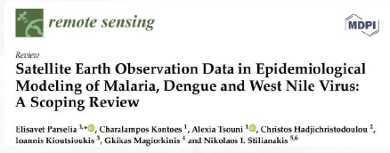
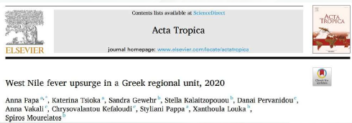
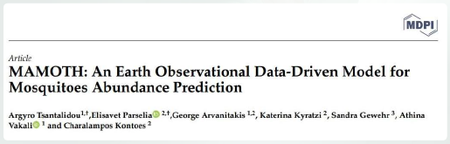
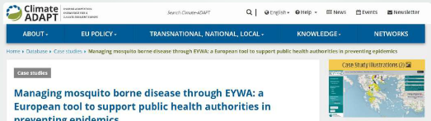
Scientific Publications
Notes:
17

Slide 18
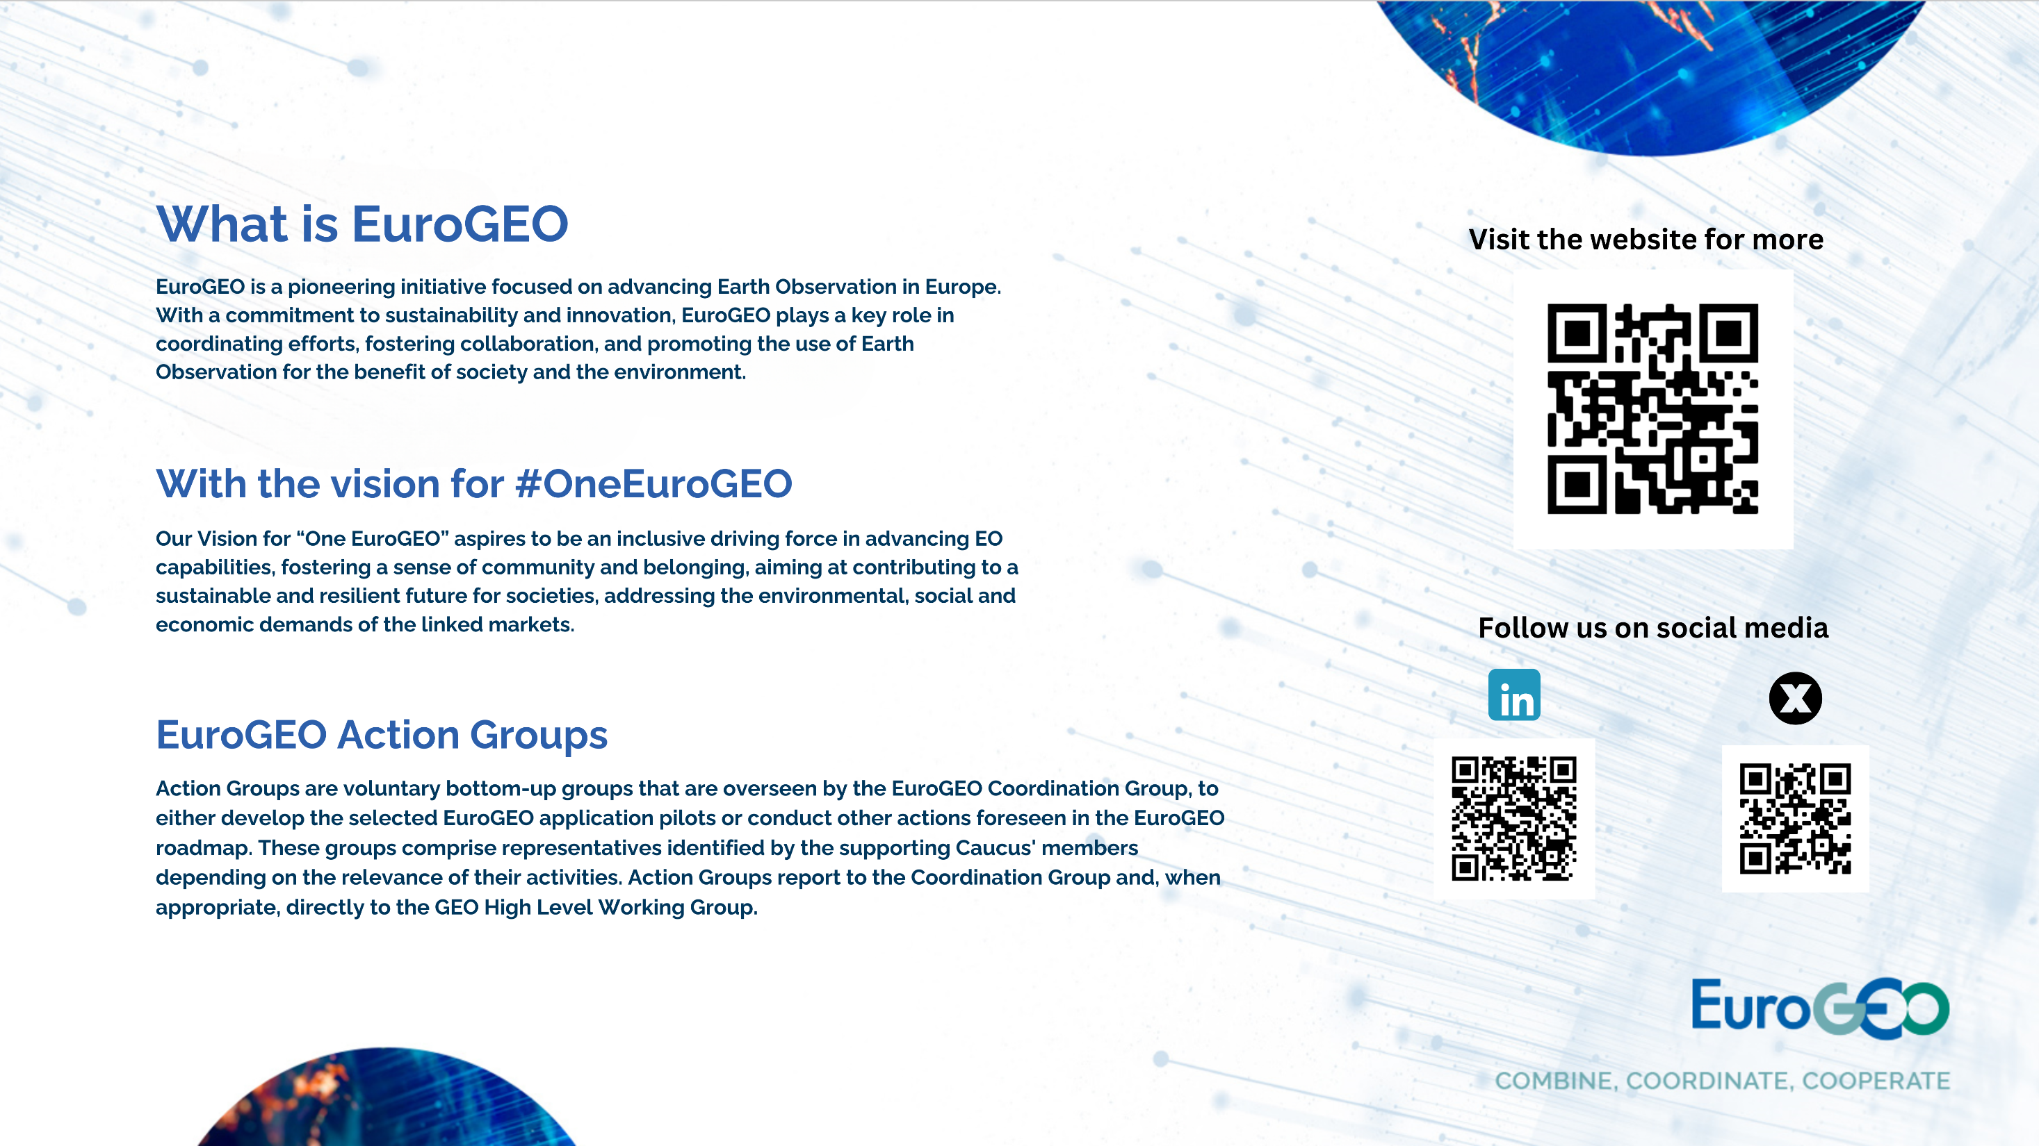
Thank you for your attention!

